Slide 1

Data Structures Using C++ 2E
Chapter 2
Object-Oriented Design (OOD) and C++

Slide 2
Objectives
Learn about inheritance
Learn about derived and base classes
Explore how to redefine the member functions of a base class
Examine how the constructors of base and derived classes work
Learn how to construct the header file of a derived class
Explore three types of inheritance: public, protected, and private
Learn about composition
Data Structures Using C++ 2E

Slide 3
Objectives (cont’d.)
Become familiar with the three basic principles of object-oriented design
Learn about overloading
Become aware of the restrictions on operator overloading
Examine the pointer this
Learn about friend functions
Explore the members and nonmembers of a class
Discover how to overload various operators
Learn about templates
Explore how to construct function templates and class templates
Data Structures Using C++ 2E

Slide 4
Inheritance
An “is-a” relationship
  Example: “every employee is a person”
Allows new class creation from existing classes
  Base class: the existing class
  Derived class: new class created from existing classes
    Inherits base classes’ properties
    Reduces software complexity
    Becomes base class for future derived class
Inheritance types
  Single inheritance and multiple inheritance
Data Structures Using C++ 2E

Slide 5
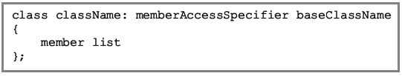
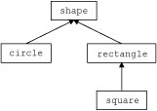
Inheritance (cont’d.)
Inheritance types
  Single inheritance and multiple inheritance
Viewed as treelike or hierarchical
  Base class shown with its derived classes
Derived class general syntax
  No memberAccessSpecifier specified ➔ private
FIGURE 2-1
Inheritance hierarchy
Data Structures Using C++ 2E

Slide 6
Inheritance (cont’d.)
Facts to keep in mind
  private base class members: private to base class
    Inaccessible to derived class
  public base class member inheritance
    public or private members of derived class
  Derived class
    Can include additional members
    Can redefine (override) public member base class functions
  All base class member variables/functions
    Derived class member variables/functions
Data Structures Using C++ 2E

Slide 7
Redefining (Overriding) Member Functions of the Base Class
Override public member function of base class in a derived class
  Same name, number, and types of parameters as base class member function
  E.g., print() in the class BoxType
vs
Function overloading
  Same name for base class functions and derived class functions
  Different sets of parameters
  Also allowed in class
It is legal to declare a data member of the same name in a derived class as the base class; Only derive class will be able to use it. Note there is only virtual function, no virtual variable.
Data Structures Using C++ 2E

Slide 8
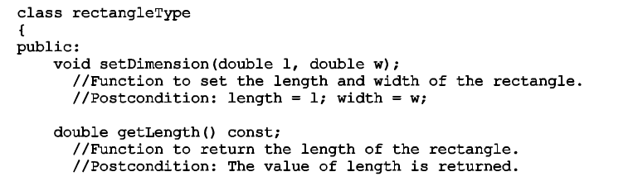
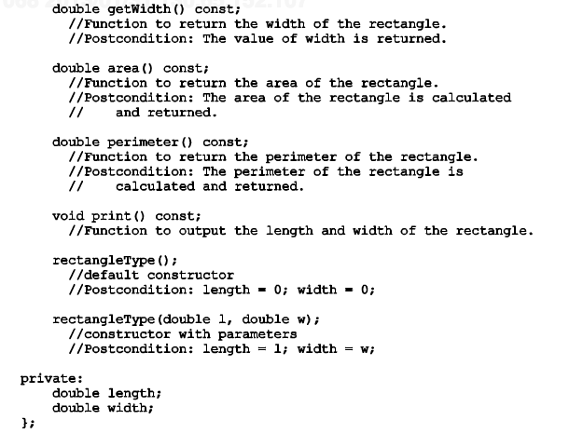
Data Structures Using C++ 2E

Slide 9
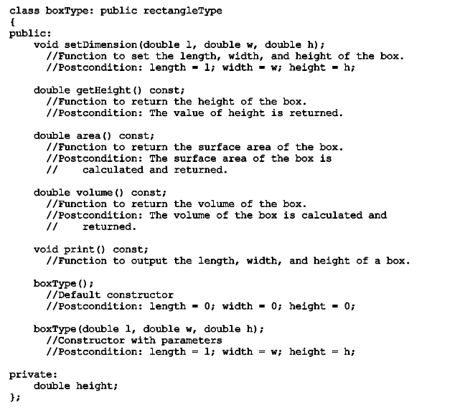
Data Structures Using C++ 2E

Slide 10
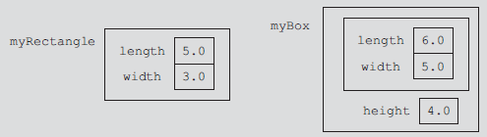
Constructors of Derived and Base Classes
Derived class with own private member variables
  Explicitly includes its own constructors
Constructors
  Initialize member variables
Declared derived class object inherits base class members
  Cannot directly access private base class data
  Same is true for derived class member functions
Data Structures Using C++ 2E

Slide 11
Constructors of Derived and Base Classes (cont’d.)
Derived class constructors can only directly initialize inherited members (public data)
Derived class object must automatically execute base class constructor
  Triggers base class constructor execution
  Call to base class constructor specified in heading of derived class constructor definition
Data Structures Using C++ 2E

Slide 12
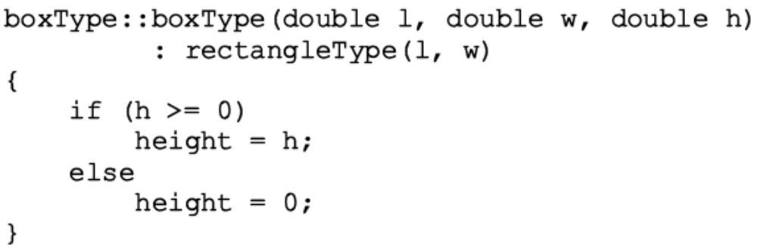
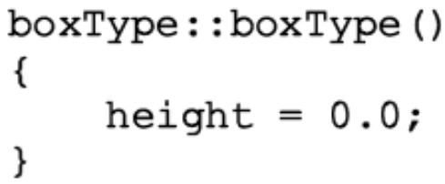
Constructors of Derived and Base Classes (cont’d.)
Example: class rectangleType contains default constructor
  Does not specify any constructor of the class boxType
  Constructor of class boxType will be called first
Write the definitions of constructors with parameters
Data Structures Using C++ 2E

Slide 13
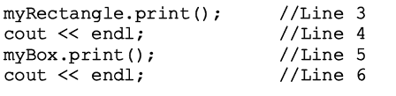

Constructors of Derived and Base Classes (cont’d.)
Consider the following statements
Data Structures Using C++ 2E

Slide 14


Data Structures Using C++ 2E

Slide 15
Header File of a Derived Class
Required to define new classes
Base class already defined
  Header files contain base class definitions
New class header files contain commands
  Tell computer where to look for base classes’ definitions
baseClass.h, baseClass.cpp
derivedClass.h, derivedClass.cpp
  derivedClass.h: include baseClass.h
main/driver program: include derivedClass.h
Data Structures Using C++ 2E

Slide 16
Multiple Inclusions of a Header File
Preprocessor command include
  Used to include header file in a program
Preprocessor processes the program
  Before program compiled
Avoid multiple inclusions of a file in a program
  Use preprocessor commands in the header file
Data Structures Using C++ 2E

Slide 17
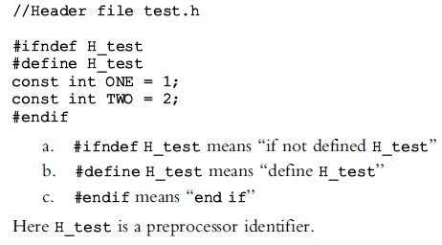
Multiple Inclusions of a Header File (cont’d.)
Preprocessor commands and meaning
Data Structures Using C++ 2E

Slide 18
Protected Members of a Class
private class members
  private to the class
  Cannot be directly accessed outside the class
  Derived class cannot access private members
Solution: make private member public
  Problem: anyone can access that member
Solution: declare member as protected
  Derived class member allowed access
  Prevents direct access outside the class
Data Structures Using C++ 2E

Slide 19
public Inheritance
class B: public A
{
…
};
public members of A → public members of B
  directly accessed in class B
protected members of A → protected members of B
  can be directly accessed by B member functions and friend functions
private members of A → hidden to B
  can be indirectly accessed by B member functions and friend functions through public or protected members of A
Data Structures Using C++ 2E

Slide 20
protected Inheritance
class B: protected A
{
…
};
public members of A → protected members of B
  can be accessed by B member functions and friend functions
protected members of A → protected members of B
  can be accessed by B member functions and friend functions
private members of A → hidden to B
  can be indirectly accessed by B member functions and friend functions through the public or protected members of A
Data Structures Using C++ 2E

Slide 21
private Inheritance
class B: private A
{
…
};
public members of A → private members of B
  can be accessed by B member functions and friend functions
protected members of A → private members of B
  can be accessed by B member functions and friend functions
private members of A → hidden to B
  can be indirectly accessed by B member functions and friend functions through the public or protected members of A
Data Structures Using C++ 2E

Slide 22
Composition
Another way to relate two classes
One or more class members of class A is another class type B
Is a ‘‘has-a’’ relationship
  Example: ‘‘every person has a date of birth’’
Data Structures Using C++ 2E

Slide 23
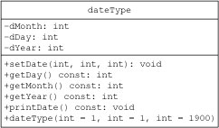
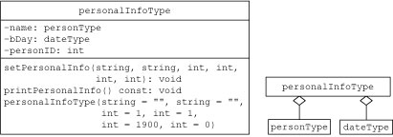
Composition (cont’d.)
FIGURE 2-7 UML class diagram of the class personalInfoType
and composition (aggregation)
FIGURE 2-6 UML
class diagram of the class dateType
Data Structures Using C++ 2E

Slide 24
Composition vs Aggregation
Composition
  One obj controls the lifetime of the other obj
  Implies ownership
  when the owning object is destroyed, so are the contained objects
  E.g. School and departments
Aggregation
  One obj not necessarily control the lifetime of the other obj
  Does not imply ownership
  when the owning object is destroyed, the other object is not necessarily destroyed
  E.g. Department and professors
Data Structures Using C++ 2E

Slide 25
Composition vs Aggregation (cont’d)
Composition
  Typically use normal member variables
  Can use pointer values if the composition class automatically handles allocation/deallocation
  Responsible for creation/destruction of subclasses
Aggregation
  Typically use pointer variables pointing to an object that lives outside the scope of the aggregate class
  Can use reference values that point to an object that lives outside the scope of the aggregate class
  Not responsible for creating/destroying subclasses
Data Structures Using C++ 2E

Slide 26
Constructor & destructor
#include <iostream>
class Base
{public:
Base() {cout<<"Constructing Base\n";}
~Base(){cout<<"Destroying Base\n";}
};
class Derive: public Base
{public:
Derive(){cout<<"Constructing Derive\n";}
~Derive(){cout<<"Destroying Derive\n";}
};
void main() {
Derive a;
}
#include <iostream>
class X
{public:
X() {cout<<"Constructing X\n";}
~X(){cout<<"Destroying X\n";}
};
class Base
{public:
Base() {cout<<"Constructing Base\n";}
~Base(){cout<<"Destroying Base\n";}
X objX;
};
class Derive: public Base
{public:
Derive(){cout<<"Constructing Derive\n";}
~Derive(){cout<<"Destroying Derive\n";}
};
void main() {
Derive a;
}
Constructing Base Constructing Derive Destroying Derive
Destroying Base
Constructing X
Constructing Base Constructing Derive Destroying Derive
Destroying Base
Destroying X
Data Structures Using C++ 2E

Slide 27
Polymorphism: Operator and Function Overloading
Encapsulation
  Ability to combine data and operations
  Object-oriented design (OOD) first principle
Inheritance
  Encourages code reuse
Polymorphism
  Occurs through operator overloading and templates
    Function templates simplify template function overloading
Data Structures Using C++ 2E

Slide 28
Operator Overloading
Why operator overloading is needed
  Built-in operations on classes
    Assignment operator and member selection operator
    Other operators cannot be directly applied to class objects
  Operator overloading
    Programmer extends most operation definitions
    Relational operators, arithmetic operators, insertion operators for data output, and extraction operators for data input applied to classes
Examples
  Stream insertion operator (<<), stream extraction operator(>>), +, and –
Data Structures Using C++ 2E

Slide 29
Operator Overloading (cont’d.)
Advantage
  Operators work effectively in specific applications
C++ does not allow user to create new operators
Overload an operator
  Write functions (header and body)
  Function name overloading an operator: reserved word operator followed by operator to be overloaded
  E.g., Function name: operator>=
Data Structures Using C++ 2E

Slide 30

Syntax for Operator Functions
Operator function
  Function overloading an operator
  Result of an operation: value
  Operator function: value-returning function
Overloading an operator for a class
  Include statement to declare the function to overload the operator in class definition
  Write operator function definition
Operator function heading syntax
Data Structures Using C++ 2E

Slide 31
Overloading an Operator: Some Restrictions
Cannot change operator precedence
Cannot change associativity
  Example: arithmetic operator + goes from left to right and cannot be changed
Cannot use default arguments with an overloaded operator
Cannot change number of arguments an operator takes
Data Structures Using C++ 2E

Slide 32
Overloading an Operator: Some Restrictions (cont’d.)
Cannot create new operators
Some operators cannot be overloaded
  . .* :: ?: sizeof
How an operator works with built-in types remains the same
Operators can be overloaded
  For objects of the user-defined type
  For combination of objects of the user-defined type and objects of the built-in type
a.*b
Dereference a pointer to class member
a is of class T; b is a pointer to a member in class T
Data Structures Using C++ 2E

Slide 33
The Pointer this
Sometimes necessary to refer to object as a whole
  Rather than object’s individual data members
Object's hidden pointer to itself
C++ reserved word
Available for use
When object invokes member function
  Member function references object’s pointer this
Data Structures Using C++ 2E

Slide 34
Friend Functions of Classes
A nonmember function of a class
  Has access to all class members (public , protected, private)
Making function as a friend of a class
  Reserved word friend precedes function prototype (in the class definition)
  Reserved word not in friend function definition/implementation
  Class name, scope resolution operator do not precede name of friend function in the function heading
Data Structures Using C++ 2E

Slide 35
Friend Functions of Classes (cont’d.)
  class a
  {
  friend void friendFunc(/*parameter*/);
  }
  void friendFunc(/*parameter*/)
  { /* can access private members of class a */
  …
  }
Data Structures Using C++ 2E

Slide 36
Member Functions and Nonmember Functions (cont’d.)
Rules for operator function
    Function overloading operators (), [], ->, or = for a class must be class member function
  Suppose operator op (such as +, >>) is overloaded for class opOverClass
    If leftmost operand of op is of different type ➔
      Function overloading operator op for opOverClass must be a nonmember (friend of class opOverClass)
    If operator function overloading operator op for class opOverClass is a member of the class opOverClass ➔
      When applying op on objects of type opOverClass, leftmost operand of op must be of type opOverClass
Data Structures Using C++ 2E

Slide 37
Member Functions and Nonmember Functions (cont’d.)
Functions overloading insertion operator (<<) and extraction operator (>>) for a class
  Must be nonmembers
    cin is an istream obj, cout is an ostream obj
Operators can be overloaded as
  Member functions or nonmember functions
  Except for exceptions noted earlier
C++ consists of binary and unary operators
C++ contains a ternary operator, (condition? a : b)
  Cannot be overloaded
Data Structures Using C++ 2E

Slide 38
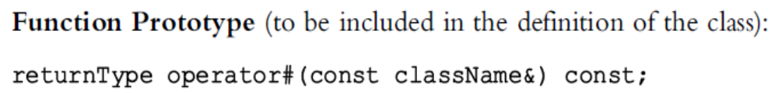
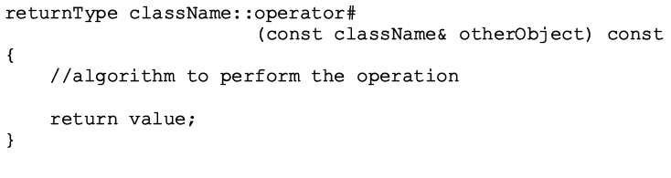
Overloading Binary Operators
Two ways to overload
  As a member function of a class
  As a friend function
As member functions
  General syntax
  Function definition – one formal parameter
Data Structures Using C++ 2E

Slide 39
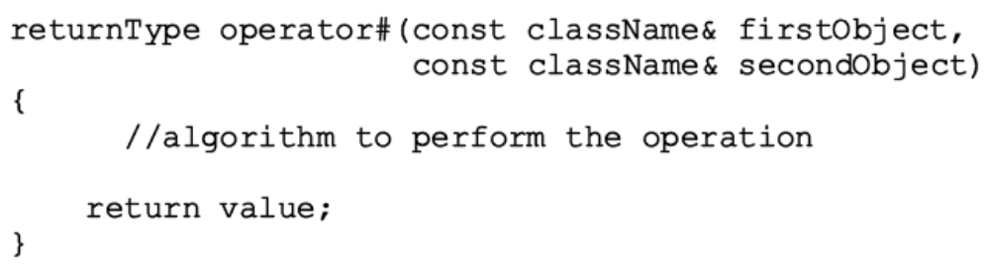
Overloading Binary Operators (cont’d.)
As friend/nonmember functions
  General syntax
  Function definition – two formal parameters
Data Structures Using C++ 2E

Slide 40
Overloading the Stream Insertion (<<) and Extraction (>>) Operators
Operator function overloading insertion operator and extraction operator for a class
  Must be nonmember function of that class
Data Structures Using C++ 2E

Slide 41
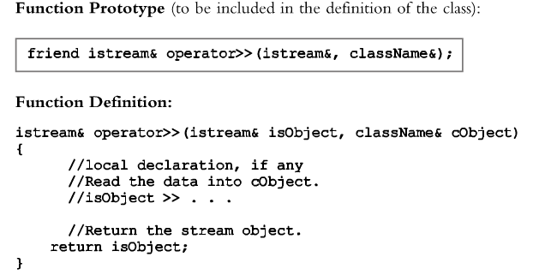
Overloading the Stream Insertion (<<) and Extraction (>>) Operators (cont’d.)
Overloading the stream extraction operator (>>)
  General syntax and function definition
Data Structures Using C++ 2E

Slide 42
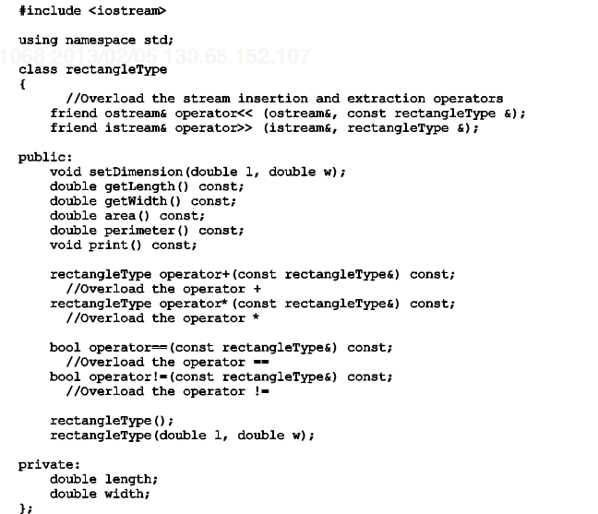
Data Structures Using C++ 2E

Slide 43
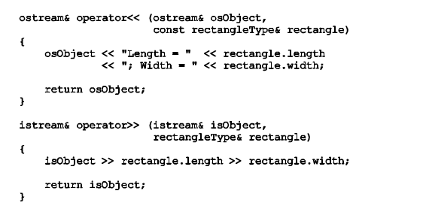
Data Structures Using C++ 2E

Slide 44
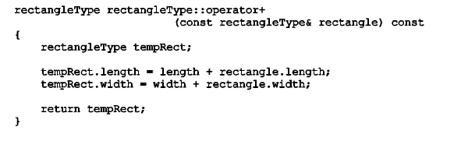
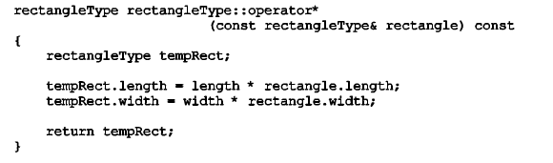
RectangleA + RectangleB ➔ RectangleA.operator+(RectangleB)
RectangleA * RectangleB ➔ RectangleA.operator*(RectangleB)
Data Structures Using C++ 2E

Slide 45
Overloading Unary Operations
Overloading unary operations
  Similar to process for overloading binary operators
  Difference: unary operator has only one argument
Process for overloading unary operators
  If operator function is a member of the class: it has no parameters
  If operator function is a nonmember (friend function of the class): it has one parameter
Data Structures Using C++ 2E

Slide 46
Operator Overloading: Member Versus
Nonmember
Certain operators can be overloaded as
  Member functions or nonmember functions
Example: binary arithmetic operator +
  As a member function
    Operator + has direct access to data members
    Need to pass only one object (right operand) as a parameter
  As a nonmember function
    Must pass both objects as parameters
    Could require additional memory and computer time
Recommendation for efficiency
  Overload operators as member functions
Data Structures Using C++ 2E

Slide 47
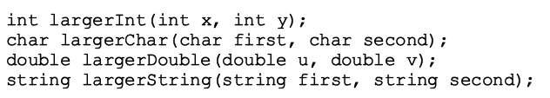
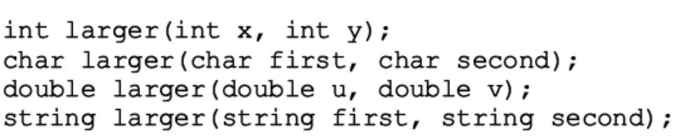
Function Overloading
Creation of several functions with the same name
  All must have different parameter set
    Parameter types determine which function to execute
  Must give the definition of each function
  Example: original code and modified code with function overloading
Data Structures Using C++ 2E

Slide 48

Templates
Function template
  Writing a single code segment for a set of related functions
Class template
  Writing a single code segment for a set of related classes
Syntax
  Data types: parameters to templates
Data Structures Using C++ 2E

Slide 49
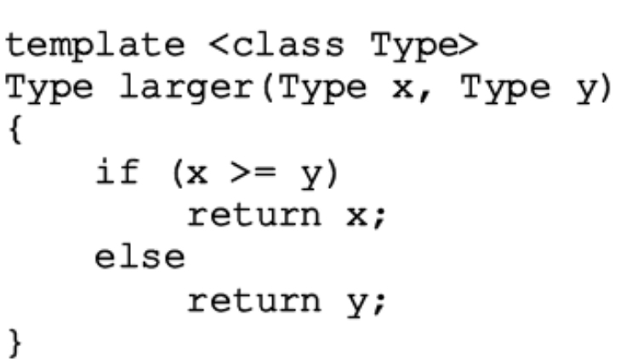
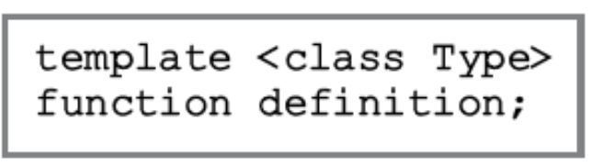
Function Templates
  Writing a single code segment for a set of related functions
Simplifies process of overloading functions
Syntax and example
Data Structures Using C++ 2E

Slide 50
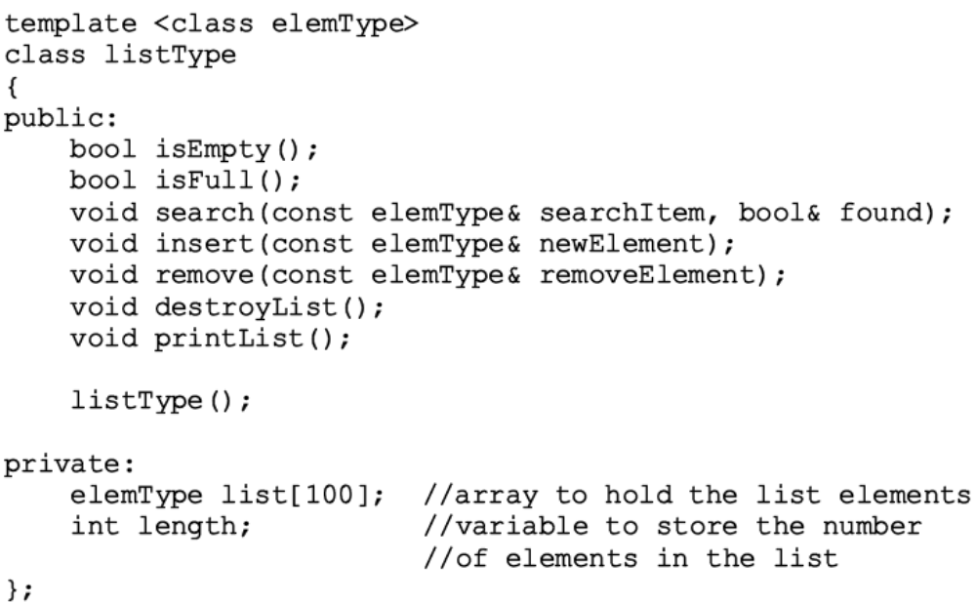
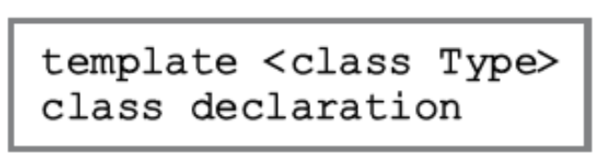
Class Templates
Used to write a single code segment for a set of related classes
Called parameterized types
  Specific class generated based on parameter type
Syntax and example
Data Structures Using C++ 2E

Slide 51
Header File and Implementation File of a Class Template
Not possible to compile implementation file independently of client code
Solution
  Put class definition and definitions of the function templates directly in client code
  Put class definition and definitions of the function templates together in same header file (recommended)
  Put class definition and definitions of the functions in separate files (as usual): include directive to implementation file at end of header file
Data Structures Using C++ 2E

Slide 52
Summary
Inheritance and composition
  Ways to relate two or more classes
  Single and multiple inheritance
  Inheritance: an ‘‘is a’’ relationship
  Composition: a ‘‘has a’’ relationship
Inheritance
  Public
  Protected
  Private
  How this affect private/protected/public member variables in base class?
Data Structures Using C++ 2E

Slide 53
Summary (cont’d.)
Three basic principles of OOD
  Encapsulation, inheritance, and polymorphism
Operator overloading
  Either member function or non-member function
  Some have to be overloaded as member functions
  Some have to be overloaded as friend/nonmember functions
friend function: nonmember of a class
Function overloading
Templates
  Write a single code segment for a set of related functions or classes
  In .h file; no .cpp file (In contract, both .h and .cpp for a class)
  Template parameter(s)
Data Structures Using C++ 2E

Slide 54
Self Exercises
Programming Exercises: 5, 6, 7, 12, 18, 19
Data Structures Using C++ 2E

